Slide 1
Data Structures
DS Lecture – Graph
Dr. Kazi A Kalpoma
Associate Professor
Faculty of Science and Information Technology
American International University Bangladesh (AIUB)
Contact: kalpoma@gmail.com

Slide 2
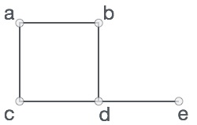
Graphs - Background
Graphs = a set of nodes (vertices) with edges (links) between them.
Notations:
G = (V, E) - graph
V = set of vertices ⎜V ⎜= n
E = set of edges ⎜E ⎜= m
In the above graph,
V = {a, b, c, d, e}
E = {ab, ac, bd, cd, de}
1
2
1
2
1
2
3
4
3
4
3
4
Directed
graph
Undirected
graph
Acyclic
graph

Slide 3
Graph Data Structure
Mathematical graphs can be represented in data-structure.
We can represent a graph using an array of vertices and a two dimensional array of edges.
Some important terms −
Vertex − Each node of the graph is represented as a vertex.
Edge − Edge represents a path between two vertices or a line between two vertices.
Adjacency − Two node or vertices are adjacent if they are connected to each other through an edge. In example given earlier, b is adjacent to a, d, c is adjacent to a, b and so on.
Path − Path represents a sequence of edges between two vertices. In example given previous, abde represents a path from a to e.

Slide 4
Basic Operations
Following are basic primary operations of a Graph which are following.
Add Vertex − add a vertex to a graph.
Add Edge − add an edge between two vertices of a graph.
Display Vertex − display a vertex of a graph.

Slide 5
Undirected Graph
2
3
8
1
10
4
5
9
11
6
7
In the above graph,
V = {1,2,3,4,5,6,7,8,9,10,11}
E = {12, 14, 25, 35, 46, 57, 67, 89, 811, 1011}

Slide 6
Directed Graph (Digraph)
2
3
8
1
10
4
5
9
11
6
7

Slide 7
Applications
It has applications in diverse fields of science and engineering:
Computer Science − Graph theory is used for the study of various algorithms.
Computer Network − The relationships among interconnected computers in the network follows the principles of graph theory.
The graphic representation of world wide web (www)
Resource allocation graph for processes that are active in the system.
The graphic representation of a map
Scene graphs: The contents of a visual scene are also managed by using graph data structure.
The concepts of graph theory is used extensively in designing circuit connections. Some examples for topologies are star, bridge, series, and parallel topologies.

Slide 8
Continuation………
Science − The molecular structure and chemical structure of a substance, the DNA structure of an organism, etc., are represented by graphs.
Linguistics − The parsing tree of a language and grammar of a language uses graphs.
General − Routes between the cities can be represented using graphs. Depicting hierarchical ordered information such as family tree can be used as a special type of graph called tree.

Slide 9
Driving Distance/Time Map
2
4
3
8
8
1
6
10
2
4
5
4
4
3
5
9
11
5
6
6
7
7
Vertex = city, edge weight = driving distance/time.

Slide 10
Undirected Graph Representation: Adjacency Matrix representation
0/1.. n x n matrix, where n = # of vertices
A(x,y) = 1 iff (x,y) is an edge, otherwise A(x,y)=0
1
2
3
4
5
2
1
0
1
0
1
0
3
2
1
0
0
0
1
1
3
0
0
0
0
1
4
4
1
0
0
0
1
5
5
0
1
1
1
0

Slide 11
Adjacency Matrix Properties
1
2
3
4
5
2
1
0
1
0
1
0
3
2
1
0
0
0
1
1
3
0
0
0
0
1
4
4
1
0
0
0
1
5
5
0
1
1
1
0
Diagonal entries are zero.
Adjacency matrix of an undirected graph is symmetric.
A(i,j) = A(j,i) for all i and j.

Slide 12
Implementation of Graph by Two-dimensional Array
#include<iostream>
using namespace std;
#define CONNECTED 1
#define DISCONNECTED 0
int main()
{
int nodes, edges, x,y;
cout<<"How many nodes? "<<endl;
cin>>nodes;
//Declere the matrix for graph
int Graph[nodes+1][nodes+1];

Slide 13
Continuation………
// initializing matrix by zero using no. of nodes
int i,j;
for( i=1;i<=nodes; i++)
for( j=1; j<=nodes; j++)
{
Graph[i][j]= DISCONNECTED;
}
cout<<"How many edges? ";
cin>>edges;
// take connected edge info from user and initialize graph
for(i=1; i<=edges; i++)
{
cout<<"Enter node x and y for edge "<<i<<endl;
cin>>x>>y;
Graph[x][y]=Graph[y][x]= CONNECTED;
}

Slide 14
Continuation….
//Print the adjacent matrix
cout<<"Adjacent Matrix: "<<endl;
for( i=1;i<=nodes; i++)
{
for( j=1; j<=nodes; j++)
{
cout<<Graph[i][j]<<" ";
}
cout<<endl;
}
return 0;
}

Slide 15
Spanning Tree
A spanning tree is a subset of Graph G, which has all the vertices covered with minimum possible number of edges.
Hence, a spanning tree does not have cycles and it can not be disconnected.
Subgraph is a tree.
If original graph has n vertices, the spanning tree has n vertices and n-1 edges.

Slide 16
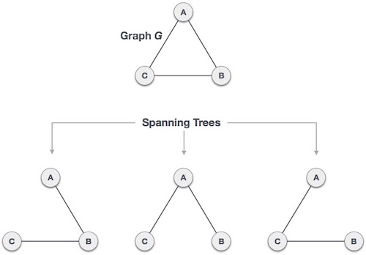
A complete undirected graph can have maximum n^{n-2} number of spanning trees,
where n is number of nodes. In addressed example, n is 3, hence 3³⁻² = 3 spanning trees are possible.

Slide 17
General properties of spanning tree
Below are few properties of spanning tree of given connected graph G −
A connected graph G can have more than one spanning tree.
All possible spanning trees of graph G, have same number of edges and vertices.
Spanning tree does not have any cycle (loops)
Removing one edge from spanning tree will make the graph disconnected i.e. spanning tree is minimally connected.
Adding one edge to a spanning tree will create a circuit or loop i.e. spanning tree is maximally acyclic.

Slide 18
Mathematical properties of spanning tree
Spanning tree has n-1 edges, where n is number of nodes (vertices)
From a complete graph, by removing maximum e-n+1 edges, we can construct a spanning tree.
A complete graph can have maximum nn-2 number of spanning trees.

Slide 19
Application of Spanning Tree
Spanning tree is basically used to find minimum paths to connect all nodes in a graph. Common application of spanning trees are −
Civil Network Planning
Computer Network Routing Protocol
Cluster Analysis

Slide 20
A Spanning Tree
2
4
3
8
8
1
6
10
2
4
5
4
4
3
5
9
8
11
5
6
2
6
7
7
Spanning tree cost = 51.

Slide 21
Minimum Cost Spanning Tree
2
4
3
8
8
1
6
10
2
4
5
4
4
3
5
9
8
11
5
6
2
6
7
7
Spanning tree cost = 41.
Notes:
In the communication networks area, we are interested in finding minimum cost spanning trees.

Slide 22
Minimum Spanning-Tree Algorithm
We shall learn about two most important spanning tree algorithms −
Kruskal's Algorithm
Prim's Algorithm
Both are greedy algorithms.

Slide 23
Graph Search Methods
Many graph problems solved using a search method.
Path from one vertex to another.
Is the graph connected?
Find a spanning tree.
Etc.
Commonly used search methods:
Breadth-first search (BFS).
Depth-first search (DFS).

Slide 24
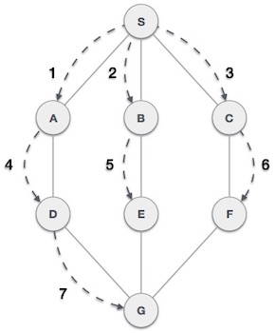
Breadth First Traversal (BFS)
Breadth First Search algorithm(BFS) traverses a graph in a breadth wards motion and uses a queue to remember to get the next vertex to start a search when a dead end occurs in any iteration.
As in example given above, BFS algorithm traverses from A to B to C to D first then to E and F lastly to G.

Slide 25
BFS Algorithm
Rule 1 − Visit adjacent unvisited node. Mark the node and Insert it in a queue.
Rule 2 − If no adjacent node found unvisited, remove the first node from the queue.
Rule 3 − Repeat Rule 1 and Rule 2 until queue is empty.

Slide 26
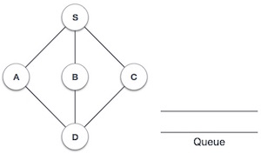
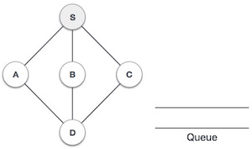
Step | Traversal | Description
1. |  | Initialize the queue.
2. |  | We start from visiting S(starting node), and mark it visited.

Slide 27
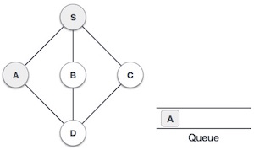
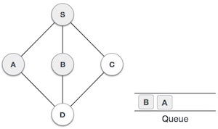
Continuation………
3. |  | We then see unvisited adjacent node from S. In this example, we have three nodes but alphabetically we choose A mark it visited and enqueue it.
4. |  | Next unvisited adjacent node from S is B. We mark it visited and enqueue it.

Slide 28
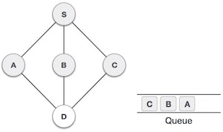
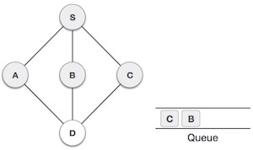
Continuation………
5. |  | Next unvisited adjacent node from S is C. We mark it visited and enqueue it.
6. |  | Now S is left with no unvisited adjacent nodes. So we dequeue and find A.

Slide 29
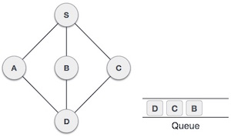
Continuation………
7. |  | From A we have D as unvisited adjacent node. We mark it visited and enqueue it.
At this stage we are left with no unmarked (unvisited) nodes. But as per algorithm we keep on dequeuing in order to get all unvisited nodes. When the queue gets emptied the program is over.

Slide 30
The implementation of BFS algorithm in C++
#include<iostream>
using namespace std;
#define unvisited -1
#define marked 0
#define visited 1
#define CONNECTED 1
#define DISCONNECTED 0
#define SIZE 100
int graph[SIZE+1][SIZE+1], label[SIZE+1];
int queue[SIZE], head, tail;
int nodes, edges;
void initialize_queue()
{
head = tail = 0;
}
void enqueue(int node)
{
queue[tail++] = node;
}
int dequeue()
{
return queue[head++];
}
bool queue_empty()
{
return head == tail;
}
void BFS(int source, int nodes);

Slide 31
The implementation of BFS algorithm in C++ (continuation…)
int main()
{
int x, y, source;
cout<<"No. of nodes: ";
cin>>nodes;
for(int i=1; i<=nodes; i++)
for(int j=1; j<=nodes; j++)
graph[i][j] = DISCONNECTED;
cout<<"No. of edges: ";
cin>>edges;
for(int i=1; i<=edges; i++)
{
cout<<"Enter vertes x and y for edge: "<< i;
cin>>x >>y;
graph[x][y] = graph[y][x] = CONNECTED;
}
initialize_queue(); // initialize queue before using
cout<<"Give source:" ; cin>>source;
BFS(source, nodes); // call bfs for graph
return 0;
}
// initializing graph with 0 using no. of nodes
// take edge info from user and initialize graph

Slide 32
void BFS(int source, int nodes)
{
for(int i=1; i<=nodes; i++)
label[i] = unvisited;
enqueue(source);
label[source] = marked;
while(!queue_empty()) // repeat until queue is empty
{
int vn = dequeue();
cout<< vn;<< " "; // print nodes in visiting sequence i.e. spanning tree
for(int v=1; v<=nodes; v++) // check all nodes for neighbour
{
if(graph[vn][v] == CONNECTED) // check connected node
{
if(label[v] == unvisited) // check if node is undiscovered
{
label[v] = marked; // mark node as discovered
enqueue(v); // insert neighbour into the queue}
}
}
label[vn] = visited; // mark node as finished
}
cout<<endl;
}
// initially mark all nodes as undiscovered
// inserting source into the queue and modifying relevant values

Slide 33
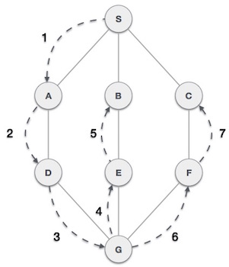
Depth First Traversal (DFS)
Depth First Search algorithm(DFS) traverses a graph in a depth ward motion and uses a stack to remember to get the next vertex to start a search when a dead end occurs in any iteration.
As in example given above, DFS algorithm traverses from A to B to C to D first then to E, then to F and lastly to G.

Slide 34
DFS Algorithm
Rule 1 − Visit adjacent unvisited vertex. Mark it visited. Display it. Push it in a stack.
Rule 2 − If no adjacent vertex found, pop up a vertex from stack. (It will pop up all the vertices from the stack which do not have adjacent vertices.)
Rule 3 − Repeat Rule 1 and Rule 2 until stack is empty.

Slide 35
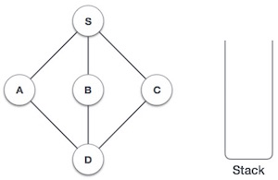
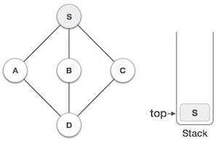
Step | Traversal | Description
1. |  | Initialize the stack
2. |  | Mark S as visited and put it onto the stack. Explore any unvisited adjacent node from S. We have three nodes and we can pick any of them. For this example, we shall take the node in alphabetical order.

Slide 36
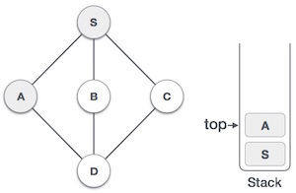
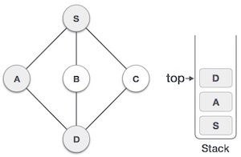
Step | Traversal | Description
3. |  | Mark A as visited and put it onto the stack. Explore any unvisited adjacent node from A. Both Sand D are adjacent to A but we are concerned for unvisited nodes only.
4. |  | Visit D and mark it visited and put onto the stack. Here we have B and C nodes which are adjacent to D and both are unvisited. But we shall again choose in alphabetical order.

Slide 37
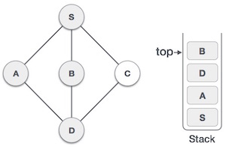
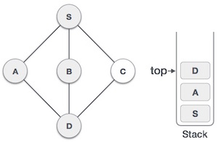
Step | Traversal | Description
5. |  | We choose B, mark it visited and put onto stack. Here B does not have any unvisited adjacent node. So we pop B from the stack.
6. |  | We check stack top for return to previous node and check if it has any unvisited nodes. Here, we find D to be on the top of stack.

Slide 38
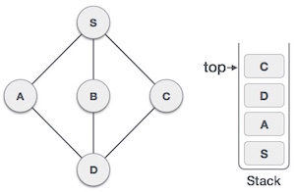
Continuation………
7. |  | Only unvisited adjacent node is from D is C now. So we visit C, mark it visited and put it onto the stack.
As C does not have any unvisited adjacent node so we keep popping the stack until we find a node which has unvisited adjacent node. In this case, there's none and we keep popping until stack is empty.

Slide 39
More Example for BFS & DFS

Slide 40
Breadth-First Search (BFS)
Visit
start vertex and put into a FIFO queue.
Repeatedly
remove a vertex from the queue,
visit its unvisited adjacent vertices,
put newly visited vertices into the queue.

Slide 41
Breadth-First Search Example
2
3
8
1
4
5
9
10
6
7
11
Start search at vertex 1.

Slide 42
Breadth-First Search Example
2
FIFO Queue
1
3
8
1
1
4
5
9
10
6
7
11
Visit/mark/label start vertex and put in a FIFO queue.

Slide 43
Breadth-First Search Example
2
FIFO Queue
1
3
8
1
1
4
5
9
10
6
7
11
Remove 1 from Q; visit adjacent unvisited vertices;
put in Q.

Slide 44
Breadth-First Search Example
2
FIFO Queue
2
3
2
4
8
1
1
4
4
5
9
10
6
7
11
Remove 1 from Q; visit adjacent unvisited vertices;
put in Q.

Slide 45
Breadth-First Search Example
2
FIFO Queue
2
3
2
4
8
1
1
4
4
5
9
10
6
7
11
Remove 2 from Q; visit adjacent unvisited vertices;
put in Q.

Slide 46
Breadth-First Search Example
2
FIFO Queue
2
3
3
4
5
3
6
8
1
1
4
4
5
5
9
10
6
6
7
11
Remove 2 from Q; visit adjacent unvisited vertices;
put in Q.

Slide 47
Breadth-First Search Example
2
FIFO Queue
2
3
3
4
5
3
6
8
1
1
4
4
5
5
9
10
6
6
7
11
Remove 4 from Q; visit adjacent unvisited vertices;
put in Q.

Slide 48
Breadth-First Search Example
2
FIFO Queue
2
3
3
5
3
6
8
1
1
4
4
5
5
9
10
6
6
7
11
Remove 4 from Q; visit adjacent unvisited vertices;
put in Q.

Slide 49
Breadth-First Search Example
2
FIFO Queue
2
3
3
5
3
6
8
1
1
4
4
5
5
9
10
6
6
7
11
Remove 5 from Q; visit adjacent unvisited vertices;
put in Q.

Slide 50
Breadth-First Search Example
2
FIFO Queue
2
3
3
3
6
9
7
8
1
1
4
4
5
5
9
9
10
6
6
7
7
11
Remove 5 from Q; visit adjacent unvisited vertices;
put in Q.

Slide 51
Breadth-First Search Example
2
FIFO Queue
2
3
3
3
6
9
7
8
1
1
4
4
5
5
9
9
10
6
6
7
7
11
Remove 3 from Q; visit adjacent unvisited vertices;
put in Q.

Slide 52
Breadth-First Search Example
2
FIFO Queue
2
3
3
6
9
7
8
1
1
4
4
5
5
9
9
10
6
6
7
7
11
Remove 3 from Q; visit adjacent unvisited vertices;
put in Q.

Slide 53
Breadth-First Search Example
2
FIFO Queue
2
3
3
6
9
7
8
1
1
4
4
5
5
9
9
10
6
6
7
7
11
Remove 6 from Q; visit adjacent unvisited vertices;
put in Q.

Slide 54
Breadth-First Search Example
2
FIFO Queue
2
3
3
9
7
8
1
1
4
4
5
5
9
9
10
6
6
7
7
11
Remove 6 from Q; visit adjacent unvisited vertices;
put in Q.

Slide 55
Breadth-First Search Example
2
FIFO Queue
2
3
3
9
7
8
1
1
4
4
5
5
9
9
10
6
6
7
7
11
Remove 9 from Q; visit adjacent unvisited vertices;
put in Q.

Slide 56
Breadth-First Search Example
2
FIFO Queue
2
3
3
8
7
8
1
1
4
4
5
5
9
9
10
6
6
7
7
11
Remove 9 from Q; visit adjacent unvisited vertices;
put in Q.

Slide 57
Breadth-First Search Example
2
FIFO Queue
2
3
3
7
8
8
8
1
1
4
4
5
5
9
9
10
6
6
7
7
11
Remove 7 from Q; visit adjacent unvisited vertices;
put in Q.

Slide 58
Breadth-First Search Example
2
FIFO Queue
2
3
3
8
8
8
1
1
4
4
5
5
9
9
10
6
6
7
7
11
Remove 7 from Q; visit adjacent unvisited vertices;
put in Q.

Slide 59
Breadth-First Search Example
2
FIFO Queue
2
3
3
8
8
8
1
1
4
4
5
5
9
9
10
6
6
7
7
11
Remove 8 from Q; visit adjacent unvisited vertices;
put in Q.

Slide 60
Breadth-First Search Example
2
FIFO Queue
2
3
3
8
8
1
1
4
4
5
5
9
9
10
2
3
6
8
6
1
7
7
11
4
5
9
Queue is empty. Search terminates.
6
7

Slide 61
Depth-First Search
depthFirstSearch(v)
{
Label vertex v as reached.
for (each unreached vertex u
adjacenct from v)
depthFirstSearch(u);
}
Notes:
Note that vertices adjacent from v are examined one at a time. As soon as an unreached adjacent vertex u is found, a depthFirstSearch(u) is done. Remaining vertices adjacent from v are examined after depthFirstSearch(u) completes.

Slide 62
Depth-First Search Example
2
2
3
8
1
1
4
5
9
1
stack
6
7
Start search at vertex 1.
Label vertex 1 and do a depth first search from either 2 or 4.
Suppose that vertex 2 is selected.

Slide 63
Depth-First Search Example
2
2
2
3
8
1
1
4
5
5
9
1
2
stack
6
7
Label vertex 2 and do a depth first search from either 3, 5, or 6.
Suppose that vertex 5 is selectd.

Slide 64
Depth-First Search Example
2
2
2
3
8
1
1
4
5
5
5
9
9
1
2
5
stack
6
7
Label vertex 5 and do a depth first search from either 3, 7, or 9.
Suppose that vertex 9 is selected.

Slide 65
Depth-First Search Example
2
2
2
3
8
8
1
1
4
5
5
5
9
9
9
1
2
5
9
stack
6
7
Label vertex 9 and do a depth first search from either 6 or 8.
Suppose that vertex 8 is selected.

Slide 66
Depth-First Search Example
2
2
2
3
8
8
8
1
1
4
5
5
5
9
9
9
1
2
5
9
8
stack
6
6
7
Label vertex 8 and return to vertex 9.
From vertex 9 do a dfs(6).

Slide 67
Depth-First Search Example
2
2
2
3
8
8
8
1
1
4
5
5
5
9
9
9
1
2
5
9
stack
6
6
7
Label vertex 8 and return to vertex 9.
From vertex 9 do a dfs(6).

Slide 68
Depth-First Search Example
2
2
2
3
8
8
8
1
1
4
4
5
5
5
9
9
9
1
2
5
9
6
stack
6
6
6
7
Label vertex 6 and do a depth first search from either 4 or 7.
Suppose that vertex 4 is selected.

Slide 69
Depth-First Search Example
2
2
2
3
8
8
8
1
1
4
4
4
5
5
5
9
9
9
1
2
5
9
6
4
stack
6
6
6
7
7
Label vertex 4 and return to 6.
From vertex 6 do a dfs(7).

Slide 70
Depth-First Search Example
2
2
2
3
8
8
8
1
1
4
1
2
5
9
6
7
4
4
5
5
5
stack
9
9
9
6
6
6
7
7
7
Label vertex 7 and return to 6.

Slide 71
Depth-First Search Example
2
2
2
3
8
8
8
1
1
4
1
2
5
9
6
4
4
5
5
5
stack
9
9
9
6
6
6
7
7
7
Label vertex 7 and return to 6.
Return to 9.

Slide 72
Depth-First Search Example
2
2
2
3
8
8
8
1
1
4
1
2
5
9
4
4
5
5
5
stack
9
9
9
6
6
6
7
7
7
Label vertex 7 and return to 6.
Return to 9.

Slide 73
Depth-First Search Example
2
2
2
3
8
8
8
1
1
4
1
2
5
4
4
5
5
5
stack
9
9
9
6
6
6
7
7
7
Label vertex 7 and return to 6.
Return to 9.

Slide 74
Depth-First Search Example
2
2
2
3
8
8
8
1
1
4
4
4
5
5
5
9
9
9
1
2
5
stack
6
6
6
7
7
7
Return to 5.

Slide 75
Depth-First Search Example
2
2
2
3
3
8
8
8
1
1
4
4
4
5
5
5
9
9
9
1
2
5
6
6
6
7
7
7
Do a dfs(3).

Slide 76
Depth-First Search Example
2
2
2
3
3
3
8
8
8
1
1
4
4
4
5
5
5
9
9
9
1
2
5
3
stack
6
6
6
7
7
7
Label 3 and return to 5.

Slide 77
Depth-First Search Example
2
2
2
3
3
3
8
8
8
1
1
4
4
4
5
5
5
9
9
9
1
2
stack
6
6
6
7
7
7
Return to 2.

Slide 78
Depth-First Search Example
2
2
2
3
3
3
8
8
8
1
1
4
4
4
5
5
5
9
9
9
1
stack
6
6
6
7
7
7
Return to 1

Slide 79
Depth-First Search Example
2
2
2
3
3
3
8
8
8
1
1
4
4
4
5
5
5
9
9
9
stack
6
6
6
7
7
7
Return to invoking method.

Slide 80
OUT PUT:
2
3
8
1
4
5
9
6
7

Slide 81
2
3
8
1
10
4
5
9
11
6
7

